Slide 1
UX design & testing TSP Insurance portal
Team:
Tanya Malhotra
Saurabh Choudhary
Paritosh Arora

Slide 2
UX Design Flow
Information Architecture - Card Sorting
Wireframes - Moqups
Prototype – Axure
Product Demo
Usability Research Methods
Selenium - WebDriver
UX Honeycomb

Slide 3
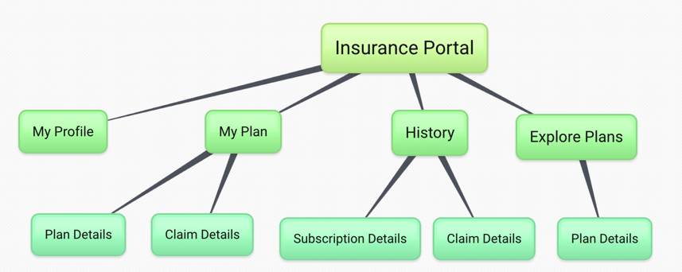
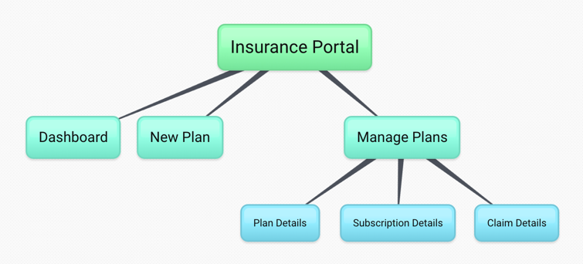
Information Architecture - Card Sorting
Employee view Employer view

Slide 4
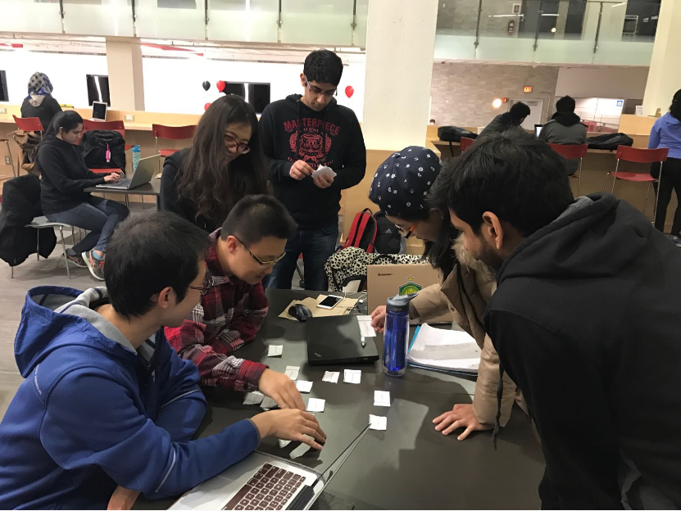
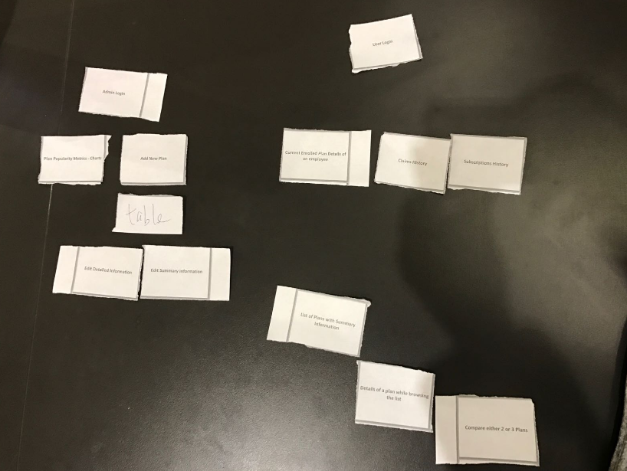
Card Sorting

Slide 5
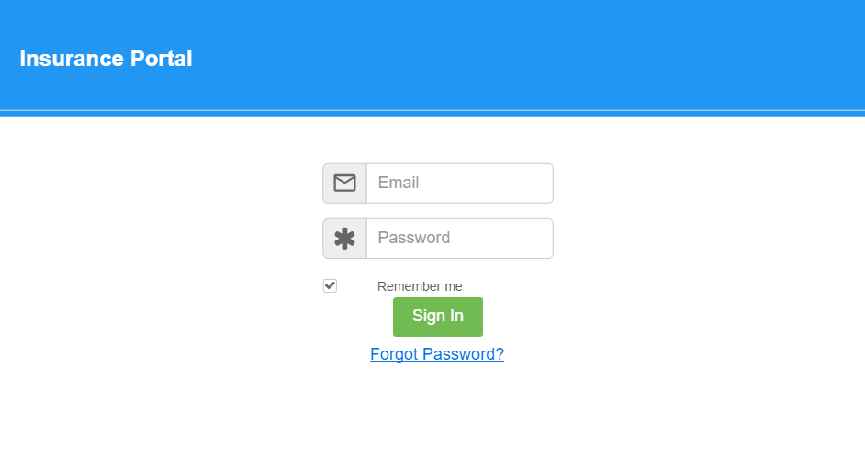
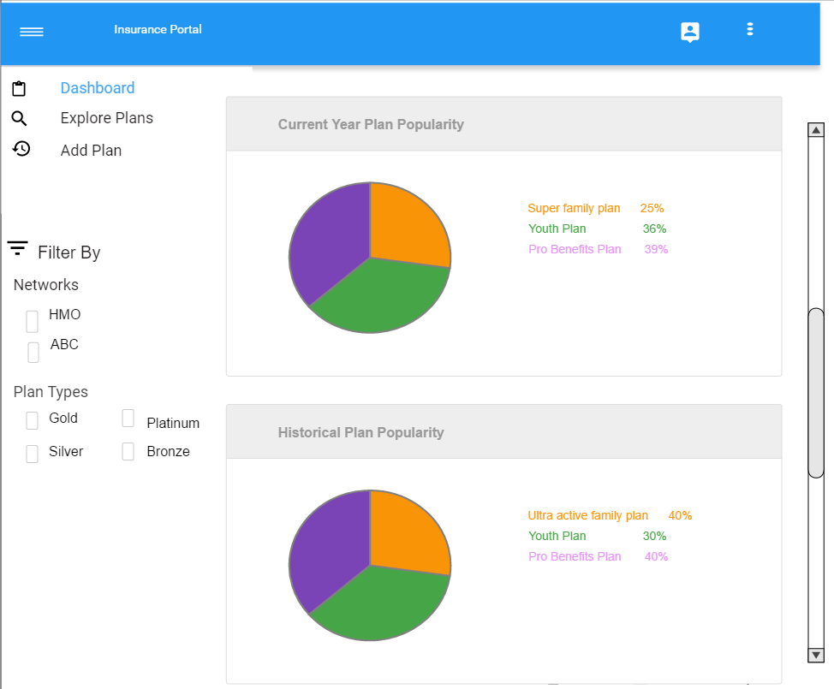
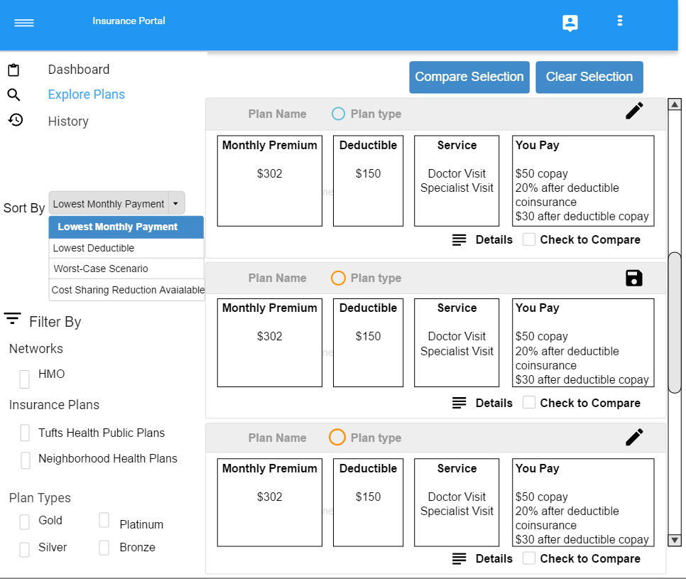
Wireframes - Moqups
Moqups – laptop (Employer)

Slide 6
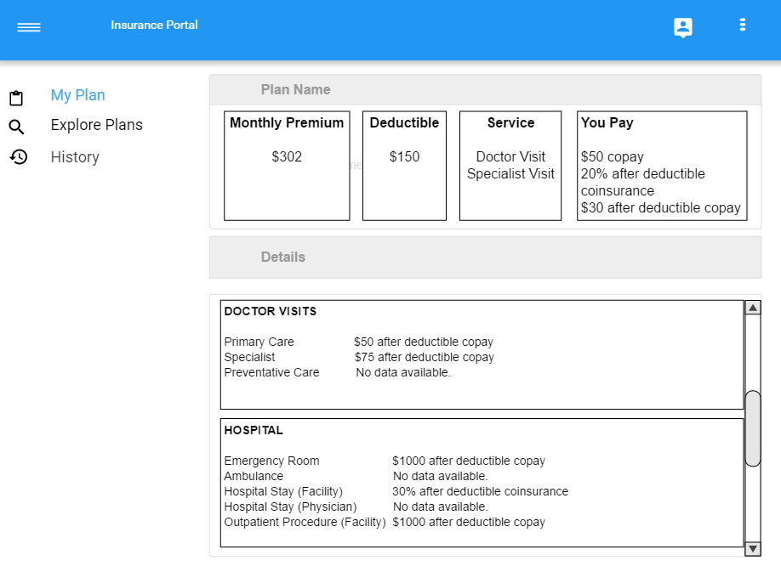
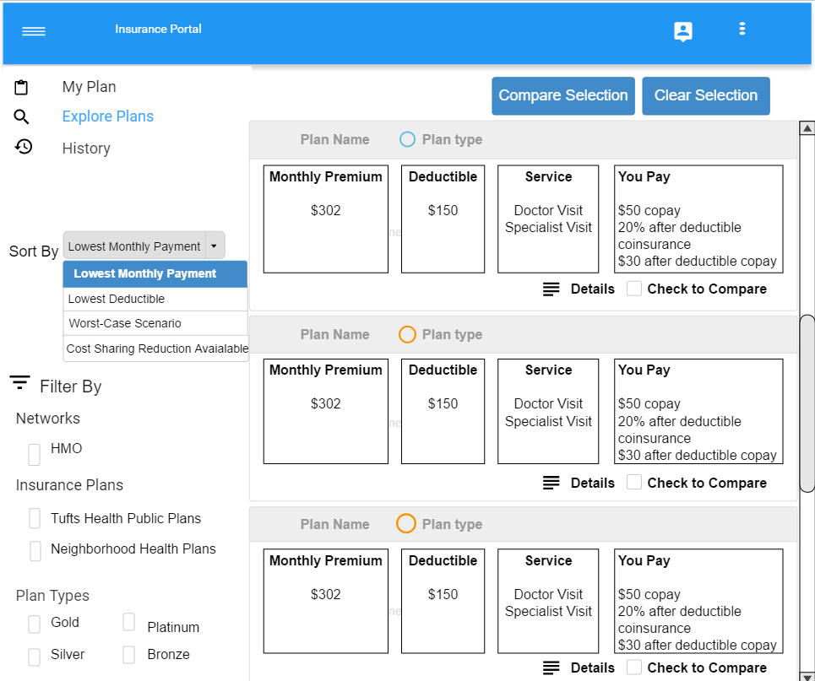
Wireframes - Moqups
Moqups – laptop (Employee)

Slide 7
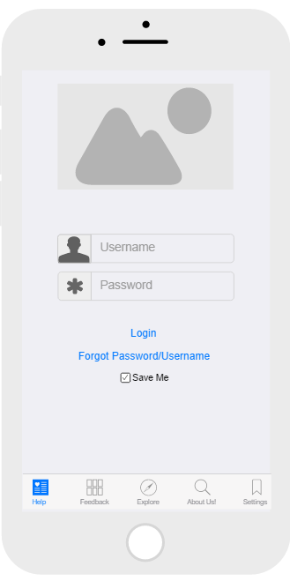
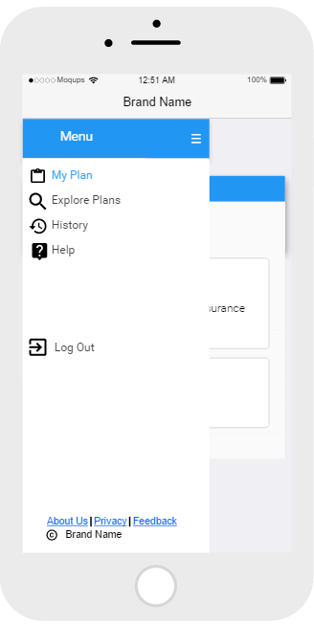
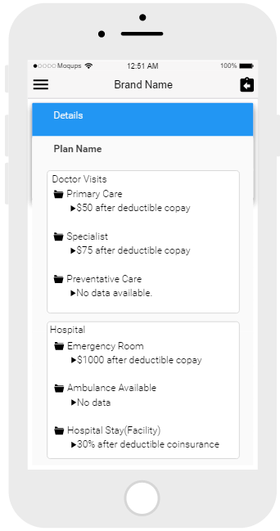
Wireframes - Moqups
Moqups – mobile

Slide 8
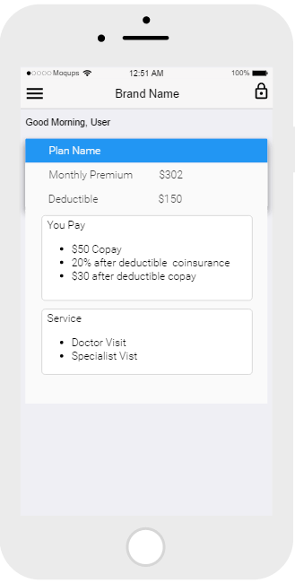
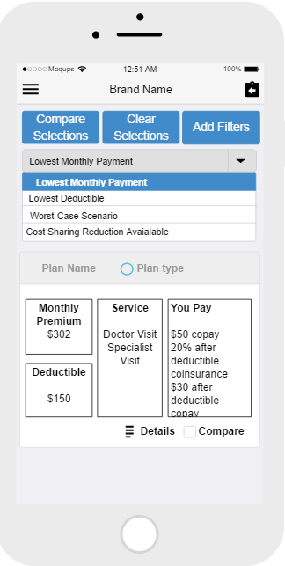
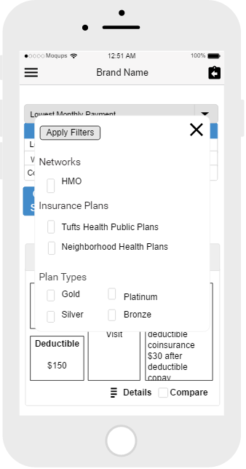
Wireframes - Moqups
Moqups – mobile

Slide 9
Prototype – Axure
Explore Plan - Filters
http://gj3e8h.axshare.com
Dashboard & Add Plan
http://zhth26.axshare.com/#g=1&p=dashboard

Slide 10
Product Demo
Role based User Experience
Employer Actions:
Dashboard
Add Plan
Edit Plan
Employee Actions:
Current Plan
Explore Plans
Compare Plans
View History

Slide 11
Usability Research Methods
Card Sorting
Interviews
Usability-Lab Studies
Ethnographic Field Studies
Customer Feedback
A/B Testing

Slide 12
Interviews
Technical Aspects
MVC vs SPA
Sort based on column headers
Business Domain
Family vs Individual Plans
Age related pricing details

Slide 13
Usability-Lab Studies
Exploring on your own for 5 minutes
Clarify their doubts, if any
Performing specific tasks of our interest
Employee
Filter plans by company name
Compare 3 plans and enroll in any one of them
Employer
Change value of monthly deductible and save it

Slide 14
Ethnographic Field Studies
Deployed website on AWS
Shared the link with participants via email
Observed user behavior via screen sharing
AWS Link:
http://ec2-35-164-13-236.us-west-2.compute.amazonaws.com:8000/login.html

Slide 15
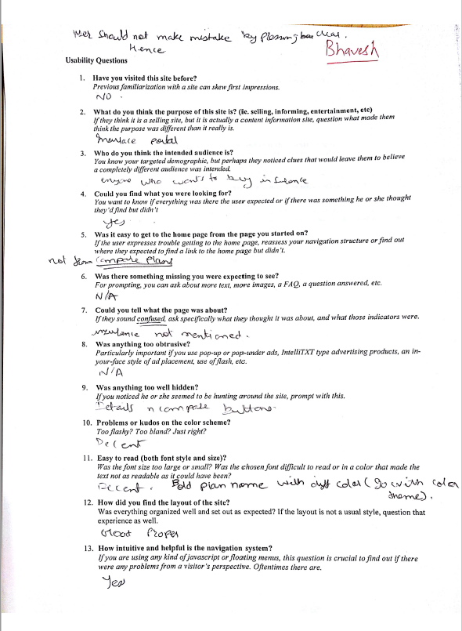
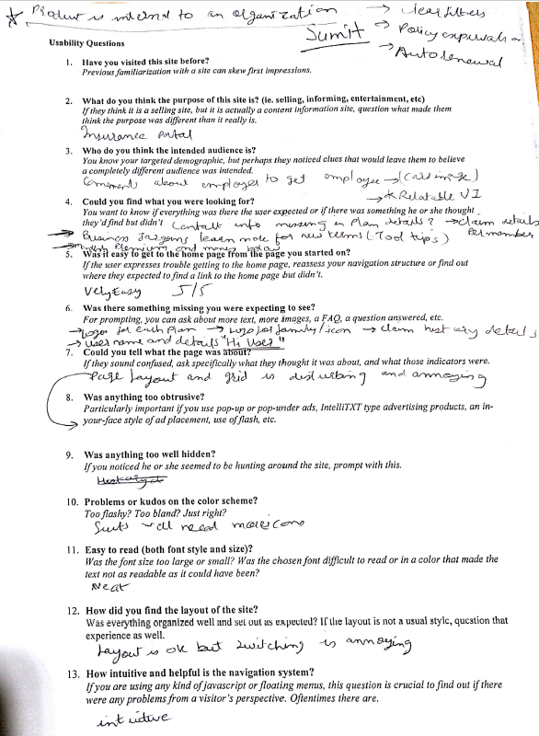
Customer Feedback
Shared the AWS link with the participants
Asked them to explore the website on their own
Shared a questionnaire with them to provide their feedback

Slide 16
A/B Testing
Two versions of History page shown to different sets of participants
One with separate Claims and Subscriptions History pages
Second with tabbed navigation for both of them on single page
Conclusion: Second group was more satisfied

Slide 17
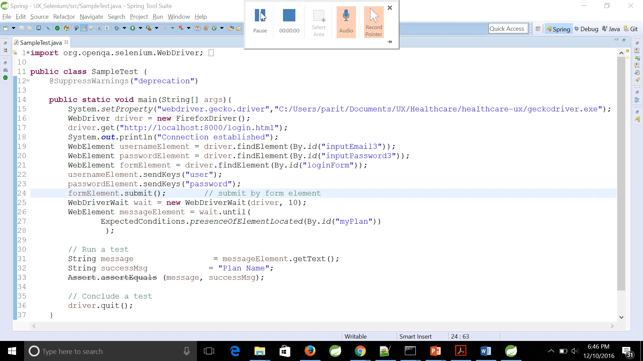
Selenium - WebDriver

Slide 18
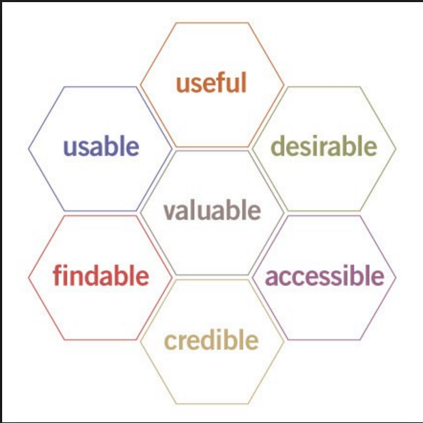
UX Honeycomb

Slide 19
THANK YOU

